Slide 1






TRAVEL ASSISTANCE
PRESENTED BY TRIP HELPER
PAGE 1

Slide 2





PROBLEM
IMPACT OF UNPREDICTABLE AND EXTREME WEATHER ON TRAVEL
Disrupts travel schedules and reduces the quality of the travel experience.
Sudden weather changes (e.g., thunderstorms, extreme heat, heavy rains) lead to cancellations of flights, events, and road closures, wasting time and money.
Travelers often miss the best travel times due to unpredictable seasonal conditions and lack of accessible tools for weather trends.
PAGE 2

Slide 3



SOLUTION
SURVEY
TESTING
CREATE
Google Form
Collect data from user
Create a prototype
Give user to test our prototype
Asking for the feedback
Weather application (Travel Assistance)
Main feature : the real-time weather data
Provides reliable, accurate, and location-specific weather updates in real time
Helping users plan their trips better and minimize disruptions
PAGE 3

Slide 4


DEFINE
IDEATE
EMPATHIZE
5 PHASES IN DESIGN THINKING
PROTOTYPE
TEST
PAGE 4

Slide 5
1
EMPATHIZE
AFTER A WEEK, WE SUCCESSFULLY GATHERED SOME DATA AND TRY TO FIND OUT THE ISSUES
WE USED GOOGLE FORM AS A SURVEY TO KNOW THE CHALLENGES FACED BY TRAVELLERS
PAGE 5

Slide 6
DEFINE
2
WE FOUND THAT WEATHER CONDITION IS THE MOST IMPORTANT FACTOR WHEN PLANNING A TRIP
MANY TRAVELLERS EXPERIENCE A TRIP RUINED WHICH CAUSES BY UNEXPECTED WEATHER CONDITION AND THEY WILL USUALLY CHANGE THEIR PLAN
THIS WILL MAKE THEM FEEL SAD AND DISAPPOINTED
PAGE 6

Slide 7
IDEATE
WE DISCUSS AND FIND THE BEST SOLUTION TO TO MEET THE USER’S NEED
WE PROPOSE AN AI-DRIVEN WEATHER-BASED TRIP PLANNING APPLICATION THAT CAN ASSIST TOURISTS AND TRAVELERS TO PREPARE FOR JOURNEYS
IT WILL BE BASED ON REAL-TIME, LOCATION-BASED, AND ACCURATE WEATHER DATA FROM TRUSTED METEOROLOGICAL SERVICES
THE AI SYSTEM WILL USE HISTORICAL TRENDS TO GIVE THE MOST ACCURATE INFORMATION TO TRAVELERS BASED ON THEIR DECISIONS ON WHEN AND WHERE TO TRAVEL
3
PAGE 7

Slide 8






PROTOTYPE
Started Interface when user open the application
PAGE 8

Slide 9
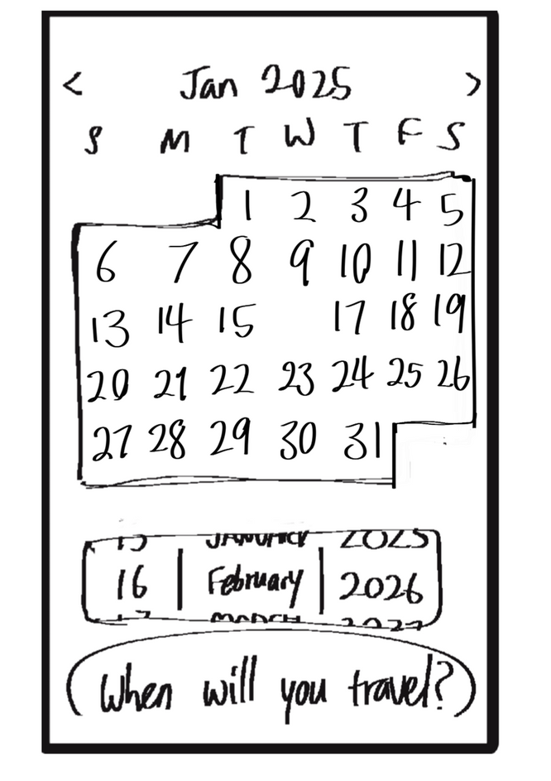


1
User Interface of choosing a date
2
Choosing with scrolling
PROTOTYPE
PAGE 9

Slide 10
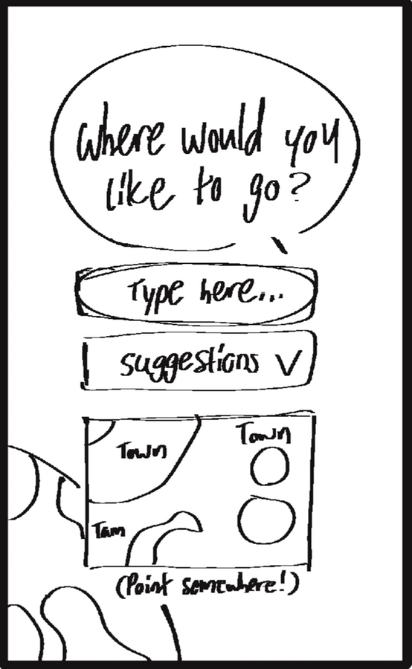
3
User Interface of choosing a place
4
Enter the location in the provided spaces even can select the place by pointing to it on the mini-map
PAGE 10

Slide 11
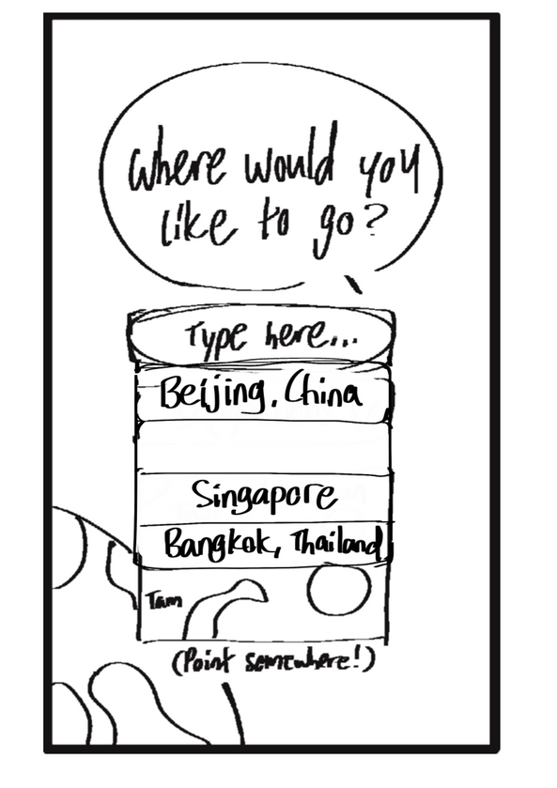

Provide the recomendation places for user
PAGE 11

Slide 12



LOADING . . .
PAGE 12

Slide 13
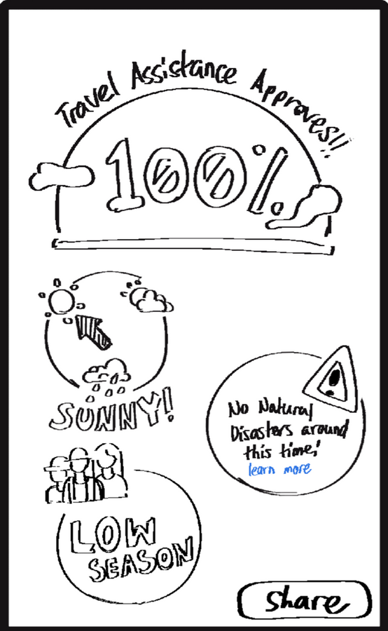





Show the awareness or confirmation that the specific period mentioned is free from any major natural disasters.
Show the weather condition with pointer
Share with your family or friend
PAGE 13

Slide 14
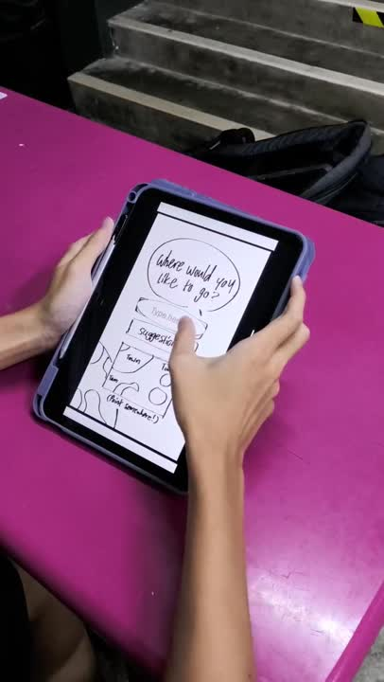
TESTING
PAGE 14

Slide 15
TIMELINE
3 JANUARY
9 JANUARY
11 JANUARY
15 JANUARY
We created a Telegram group
We decided to create a an application to predict the weather accurately
We have done a survey to know the main cause to the tourists through the google form and started to create our prototype
All members coorperate well
WE STARTED TO DISCUSS AND DO THE RESEARCH
WE STARTED TO DISTRIBUTE THE TASK
WE FINISH AND SUBMIT OUR REPORT ON TIME.
OUR PROTOTYPE HAD SUCCESSFULLY DEVELOPED AND STARTED TO TEST
PAGE 15

Slide 16





THANK YOU ！
PAGE 16

